Slide 1
1. Introduction to C++
Notes:
P.K.Shetty, MCIS, Manipal University, INDIA

Slide 2
What is C++?
C++ is an Object-oriented programming language.
Developed by Bjarne Stroustrup at AT&T Bell laboratories, USA.
C++ is an extension of C with a major addition of the class construct feature.
Initially called as “C with classes”.
Later in 1983, the name was changed to C++
C++ is an incremented version of C.
Notes:
P.K.Shetty, MCIS, Manipal University, INDIA

Slide 3
A Simple C++ program
int main()
{
return 0;
}
//my first program in C++
#include <iostream> using namespace std;
cout << “Hello, world !”;

Slide 4
Comments
Two types of comments in C++
  inline:
  multiline (C-like):
  Both types can be used in the same program, good style rule is to use the inline comment, which is quite simple and not ambiguous
const int Entries; // this is an inline comment
// the rest of the line is treated like a comment
const int Entries;
/* this is a multiline comment:
Everything is treated like a comment.
Comments can’t be nested. The comment is
closed with a */

Slide 5
I/O: read and write
Use: iostream
  This directive causes the preprocessor to add the contents of the iostream file to the program.
  The shift operators << and >> are used to define the data flow direction
  cin, cout e cerr are the standard input, output and error streams in C++
#include <iostream>

Slide 6
#include <iostream>
Lines beginning with a hash sign (#) are directives for the preprocessor. They are not regular code lines with expressions but indications for the compiler's preprocessor.
In this case the directive #include <iostream> tells the preprocessor to include the iostream standard file.

Slide 7
Namespace
Namespace is a new concept introduced by the ANSI C++ standards committee. This defines a scope for the identifiers that are used in a program.
Here std is the namespace where ANSI C++ standard class libraries are defined.
This will bring all the identifiers defined in std to the current global scope.
using namespace std;

Slide 8
using namespace std;
All the elements of the standard C++ library are declared within what is called a namespace, the namespace with the name std.
So in order to access its functionality we declare with this expression that we will be using these entities.

Slide 9
Return Type of main()
main() must return a type (which one is the programmer’s choice). Rule of the thumb is that main() return an integer, to represent the application’s return code
int main()
{
// the simplest C++ program
return 0;
}

Slide 10
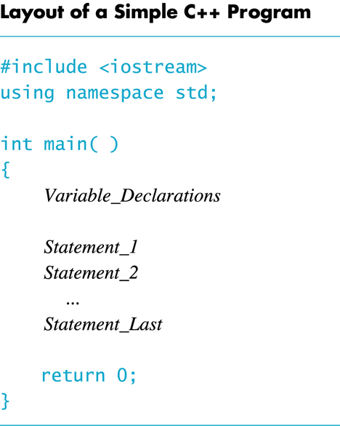

Slide 11
